Slide 1
Restoration Advisory Board Meeting
May 15, 2019

Slide 2
Agenda
January Meeting Minutes
Facility Impacts
June Soil Gas Sampling
Richmond Middle School Sampling Schedule
Feasibility Study Report Status
Groundwater Modeling
Upcoming Work

Slide 3
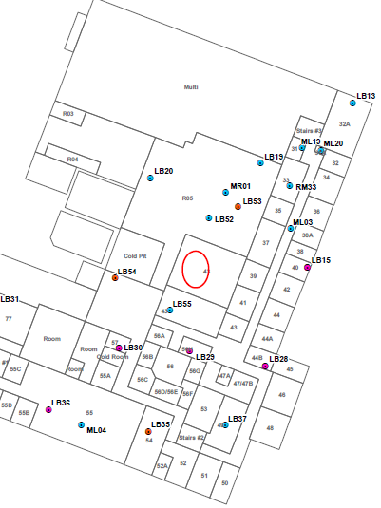
Facility Impacts
March 19th Removal of -73°C refrigeration line
Release occurred at ~0900
Increasing concentrations at 0930, 0945, and 1002
Areas of Main Lab evacuated at 1015
Work stopped and building ventilated
Release Location
Basement Level

Slide 4
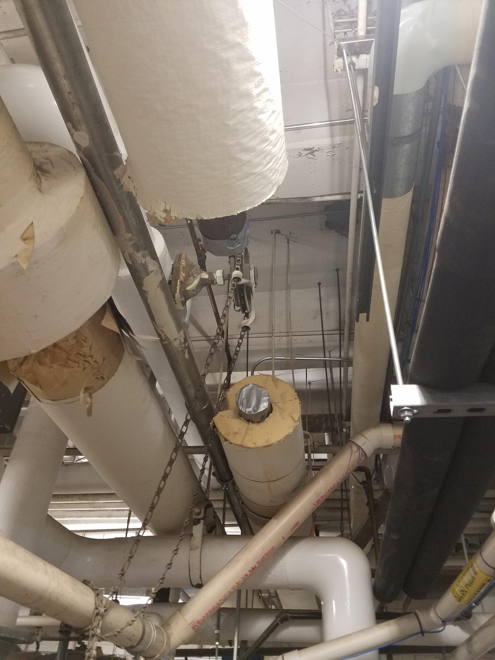
Building Reopening
March 20th
  Main Lab Addition floors 1 & 2 reopened at 1251 EST
March 21st
  All locations opened to unrestricted use at 0747
Further line removal
  Occur on weekends
  Increased ventilation and monitoring

Slide 5
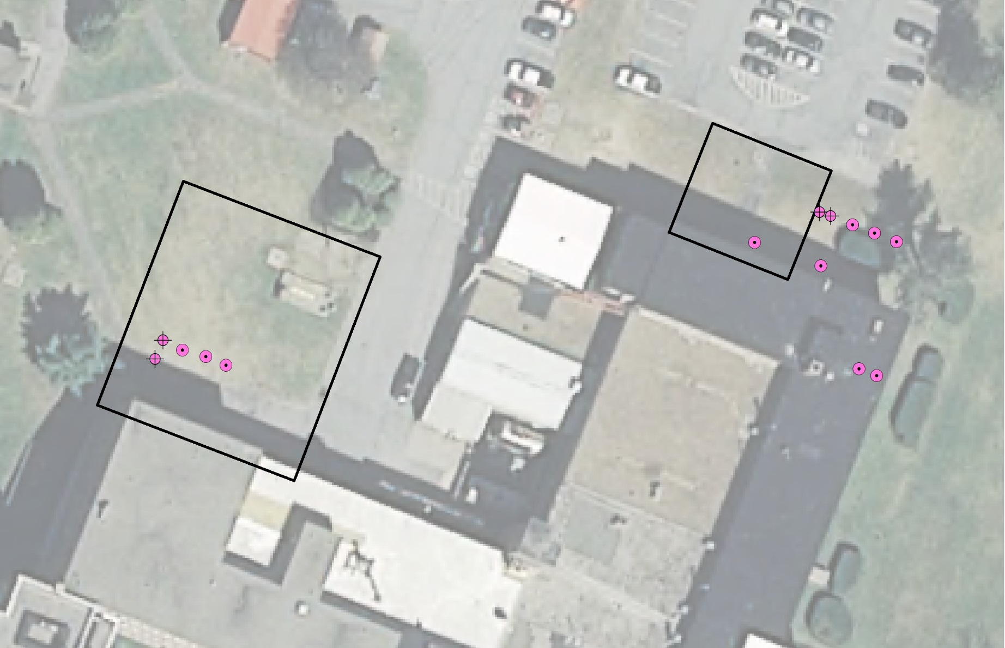
SVE Pilot Systems at AOC 2 and AOC 9 Update
AOC 2
AOC 9
Notes:
Describe AOCs
Note extraction wells shallow and deep
Monitoring locations
Video of plume is next

Slide 6
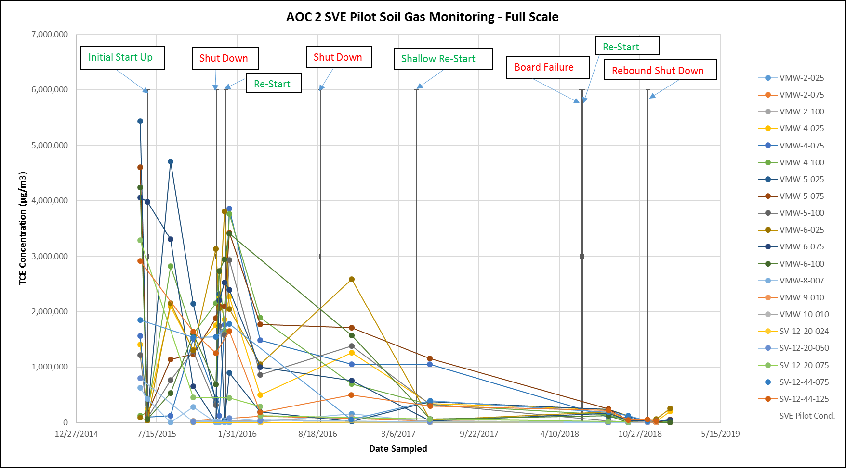
AOC 2 SVE Pilot Rebound Study
Shutdown Since November 15th.
Short Term Rebound is Very Limited, Long Term Rebound Possible

Slide 7
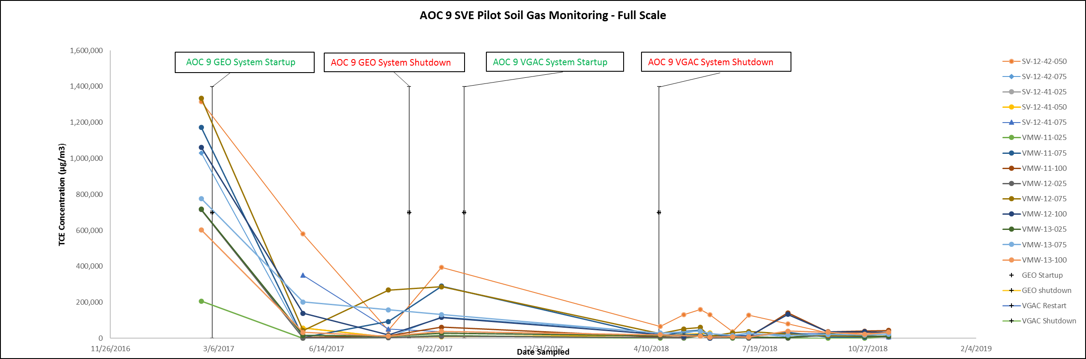
AOC 9 Rebound Study
Shutdown Since April 17, 2018
Minimal rebound observed.

Slide 8
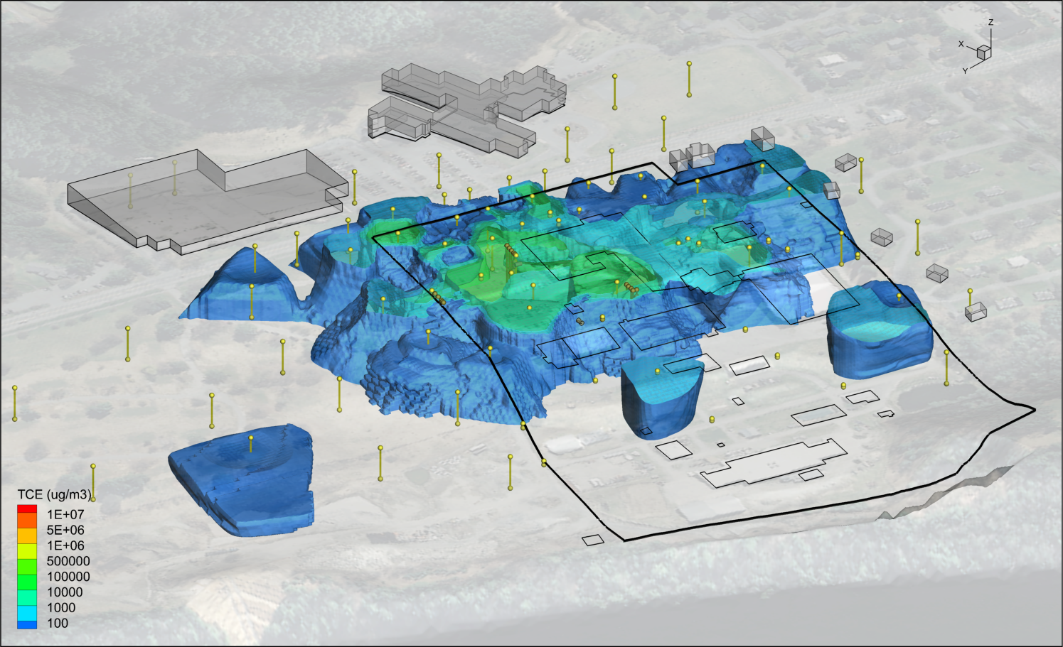
Soil Gas Sampling Early June

Slide 9
Richmond Middle School Indoor Air Sampling Schedule
Attended SAU70 School Board May 2018 Meeting
Sample December 2018
Sample in August and December 2019 (bi-annual)
Sample August 2020
Cease Monitoring following August 2020 sampling event
RMS will be evaluated as part of the 5-Year Review Cycle

Slide 10
Feasibility Study
Formal comments from USACE are being addressed
Groundwater cleanup is the key issue
Additional groundwater modeling has been performed to support remedy evaluation
Report is being revised to allow more flexibility during long-term site management

Slide 11
Groundwater Modeling
Groundwater modeling performed as part of the FS
Additional modeling performed to determine if clean-up times can be reduced
Modeled scenarios
  Site-wide treatment
  Transect treatment for up to 30 years
  Treatment with re-injection (flushing)

Slide 12
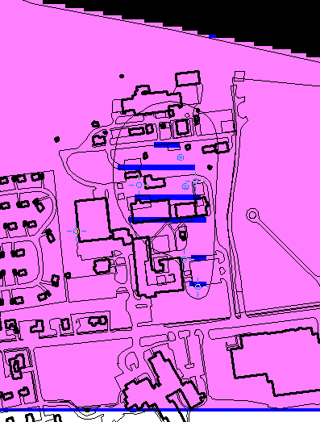
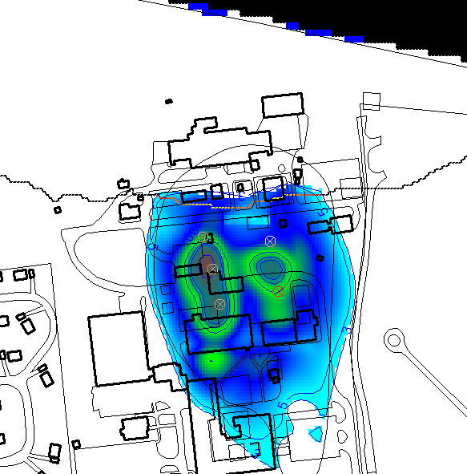
Groundwater Modeling

Slide 13
Future Work
Evaluate Vapor Intrusion at Frost Effects, snapshot sampling under different barometric conditions conducted this week. Look to sample under barometric high over the next month.
Continue to monitor rebound concentrations at AOC 2 and AOC 9.
Norwich Well Sampling
Synoptic Soil Gas Sampling early June
Enhanced Permeability Pilot Testing Fall 2019

Slide 14
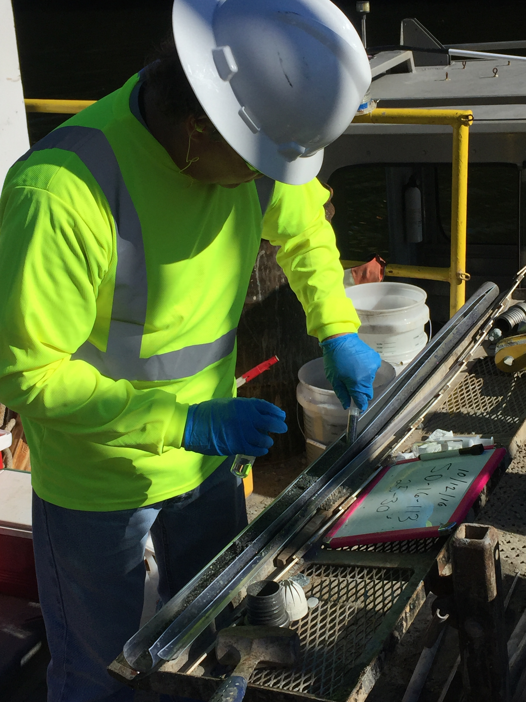
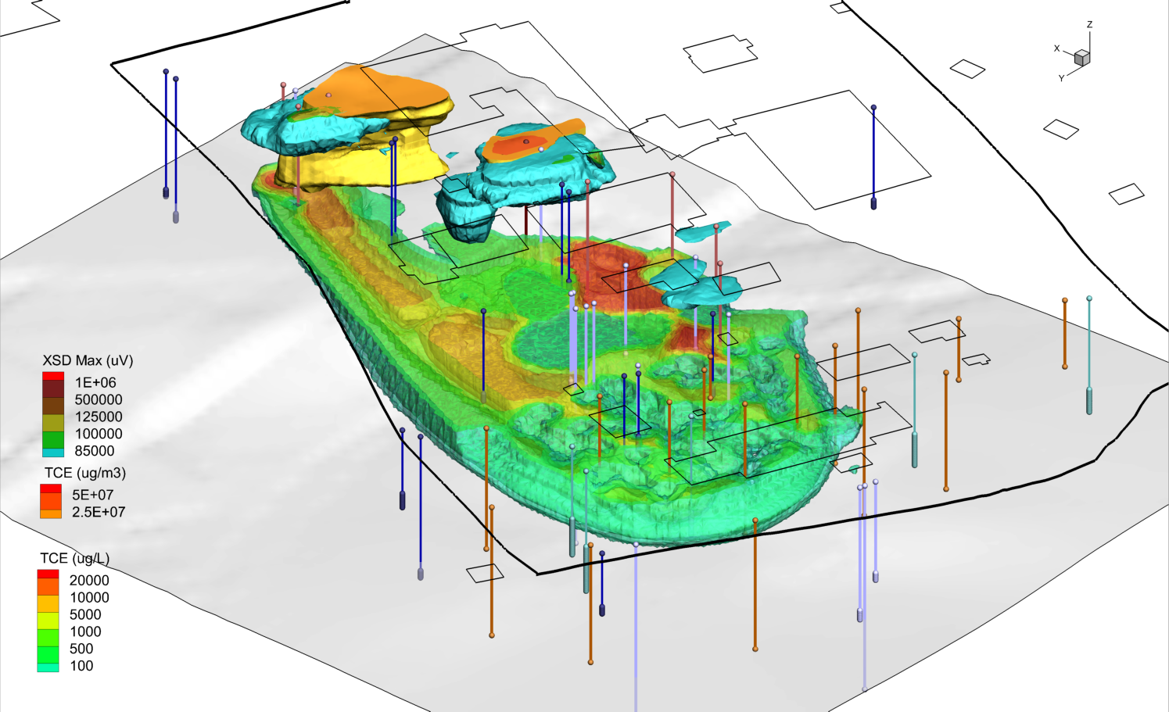
Thank You
Questions or Comments

